Slide 1
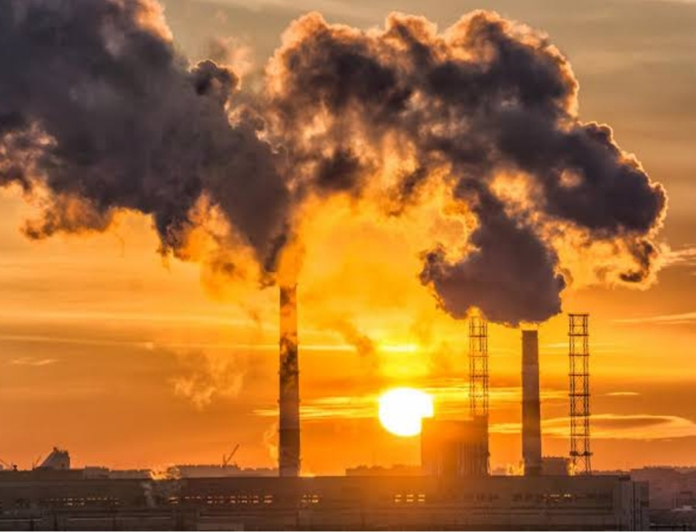
UNEARTHING THE ENVIRONMENTAL IMPACT OF HUMAN ACTIVITY: A Global CO2 emission analysis.

Slide 2
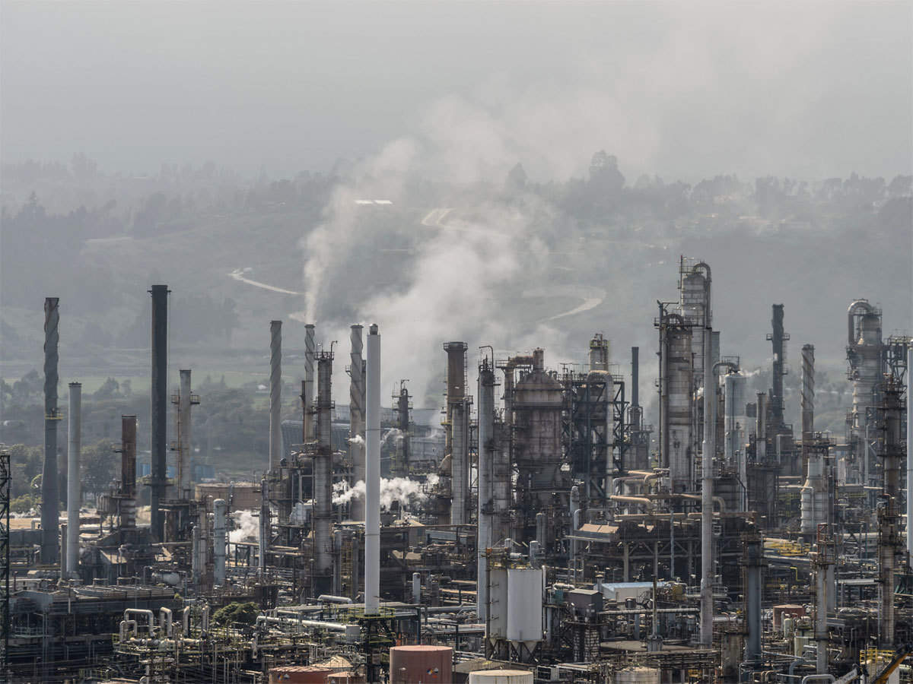
OVERVIEW
CO2 emissions from energy combustion
and industrial process and accounted for
close to 89% of energy sector greenhouse
gas emissions in 2021.

Slide 3
PURPOSE
The carbon in CO2 can be used to produce fuels that are in use today, including methane, methanol, gasoline and aviation fuels.
CO2 use has potential to support climate goals, but robust life-cycle assessment is essential.
CO2 could be an important raw material for products that require carbon.

Slide 4
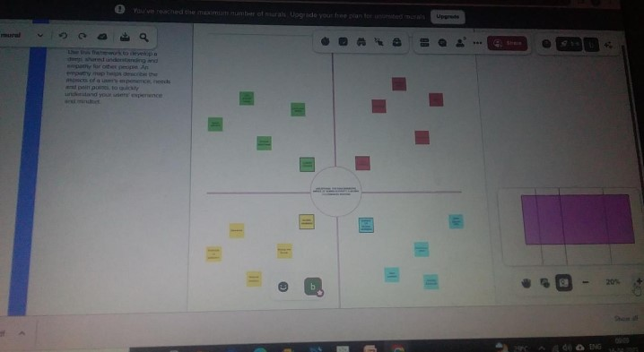
DESIGN THINKING

Slide 5
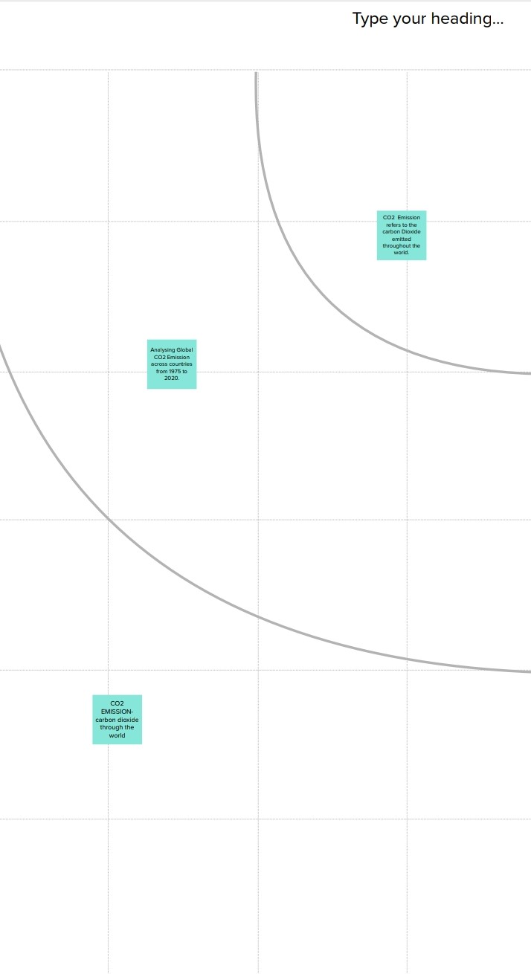
GRAPHICAL PRESENTATION

Slide 6
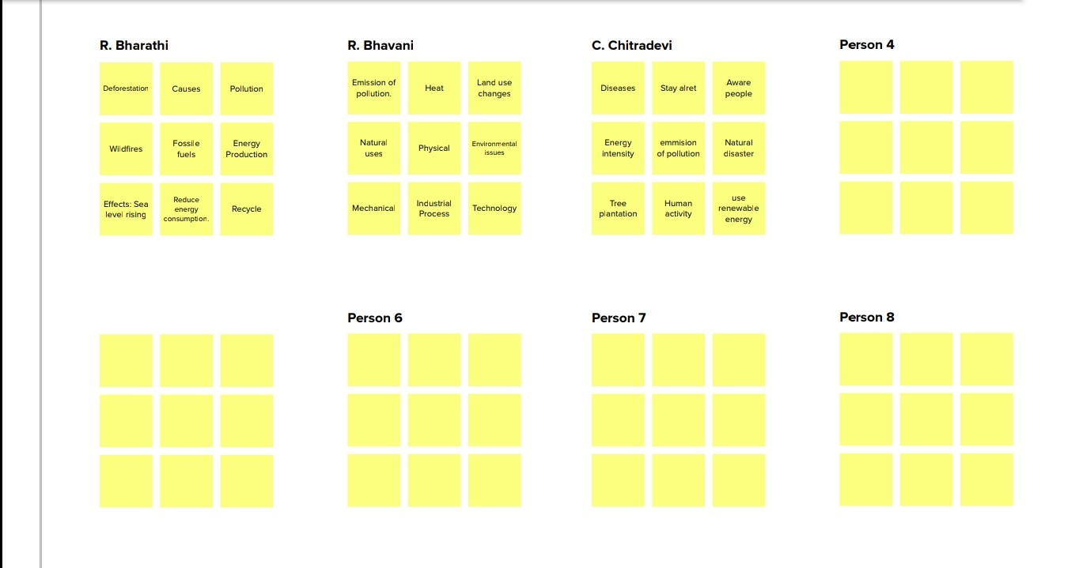
BRAINSTORMING IDEAS

Slide 7
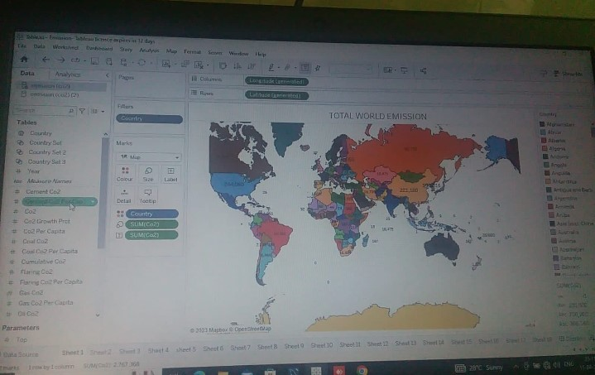
DASHBOARD 1

Slide 8
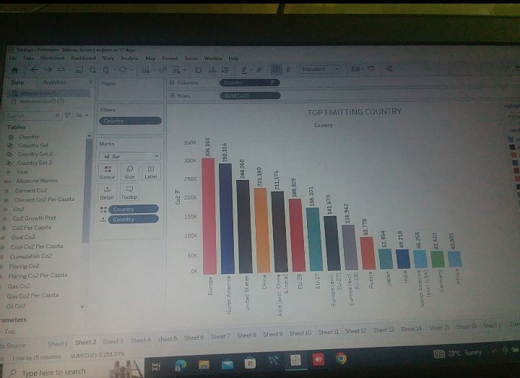

Slide 9
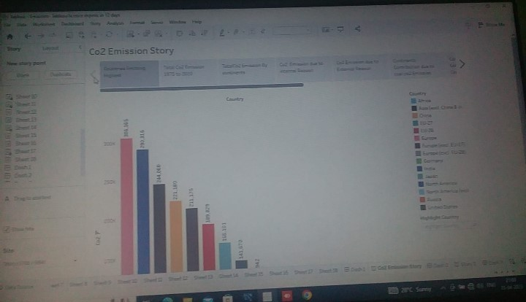

Slide 10
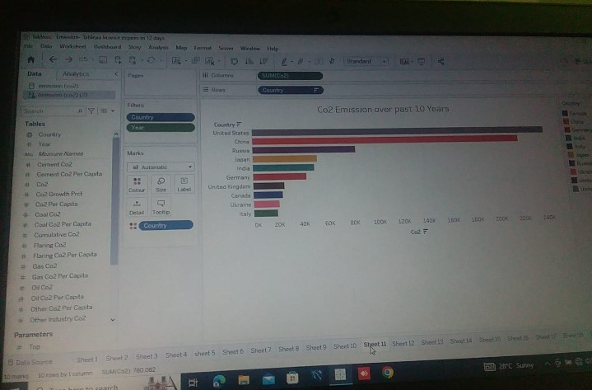
DASHBOARD 2

Slide 12
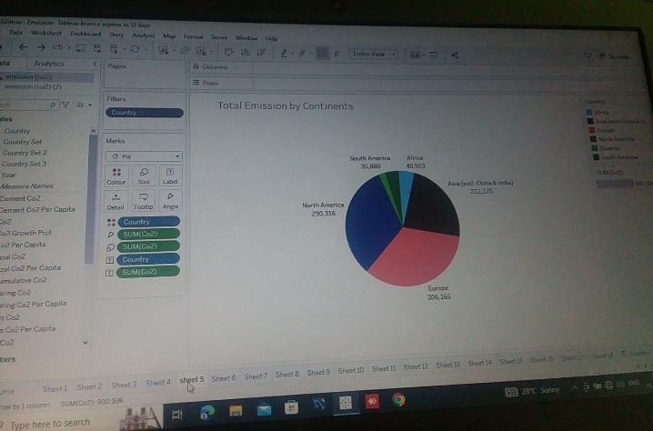

Slide 13
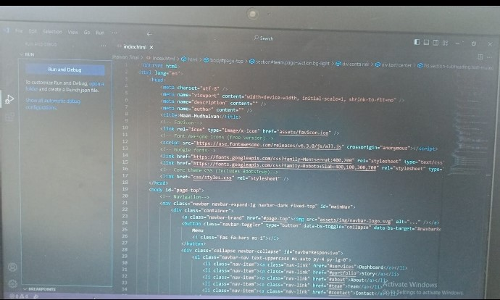
SOURCE CODE

Slide 14
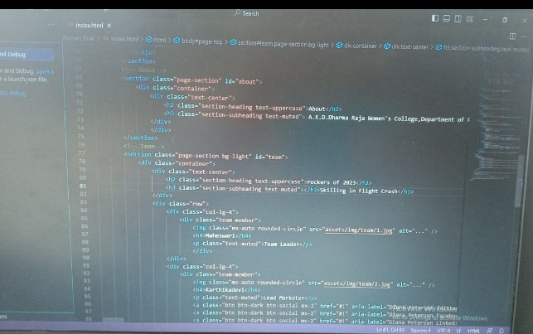

Slide 15
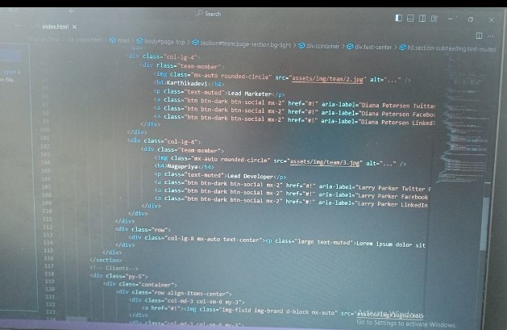

Slide 16
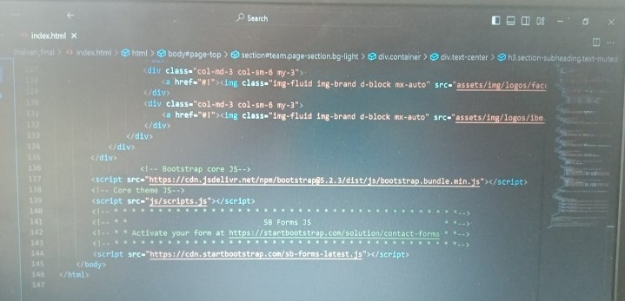

Slide 17
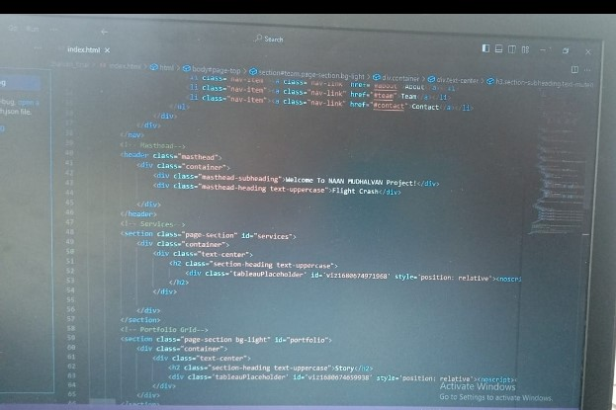

Slide 18
PROBLEM
The amount of carbon emissions trapped in our atmosphere causes global warming ,which causes climate change ,symptoms of which include melting of the polar ice caps ,the rising of sea levels ,the disturbance of animals natural habitats , extreme weather events ,and so many more negative side effect that are dangerous.

Slide 19
SUMMARY
→ Carbon dioxide is an important heat-trapping gas , or greenhouse gas , that comes from the extraction and burning of fossil fuels , from wildfires ,and from natural processes like volcanic eruptions
→ Carbon dioxide is a colourless and non-flammable gas at normal temperature and pressure

Slide 20
TEAM LEADER : R.Bharathi.
TEAM MEMBER: R. Bhavani,
S.Chitra devi.

